Slide 1
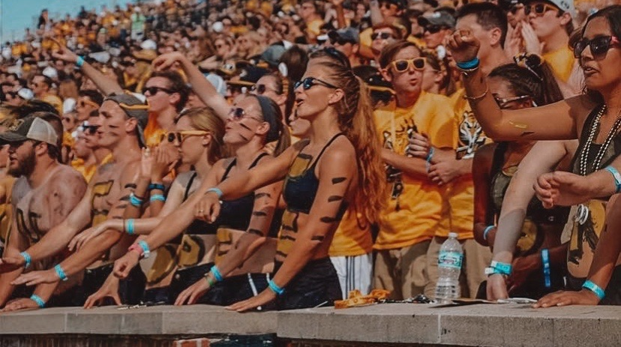

Reimagining the Game Day Experience
Ⓒ 2020 AT&T Intellectual Property. AT&T, Globe lolo, and DIRECTTV are registered trademarks and service marks of AT&T Intellectual Property and/or AT&T affiliated companies. All other marks are the property of their respective owners.
AT&T Proprietary (Internal Use Only) - Not for the use or disclosure outside the AT&T companies except under written agreement.
1

Slide 2

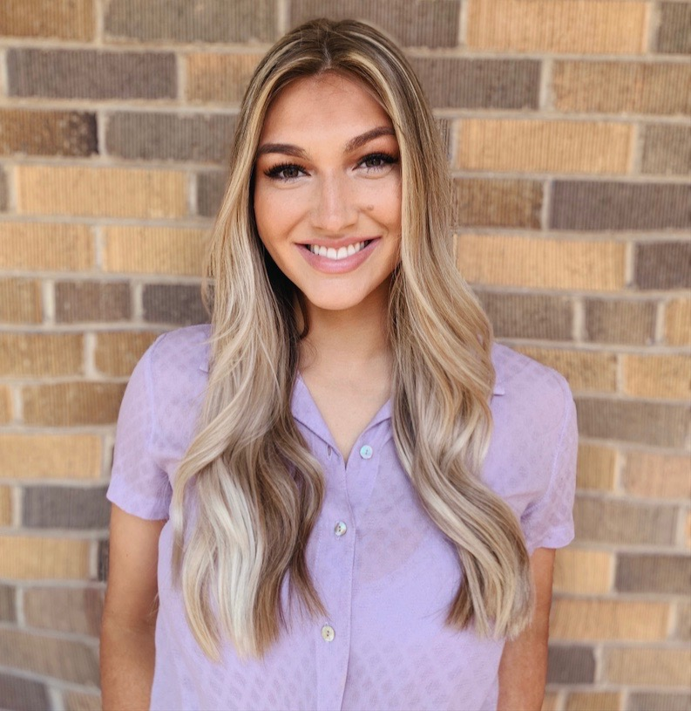
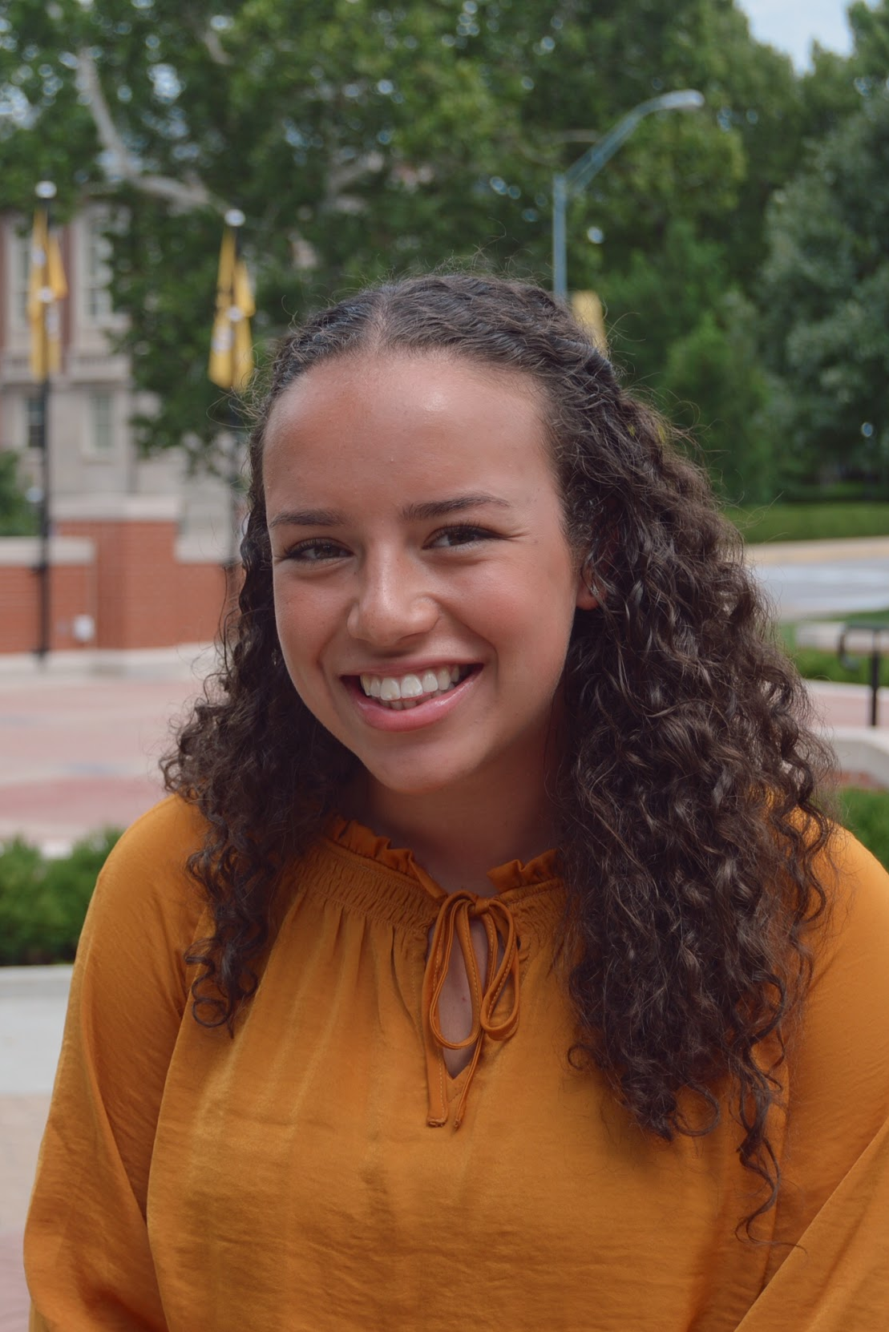
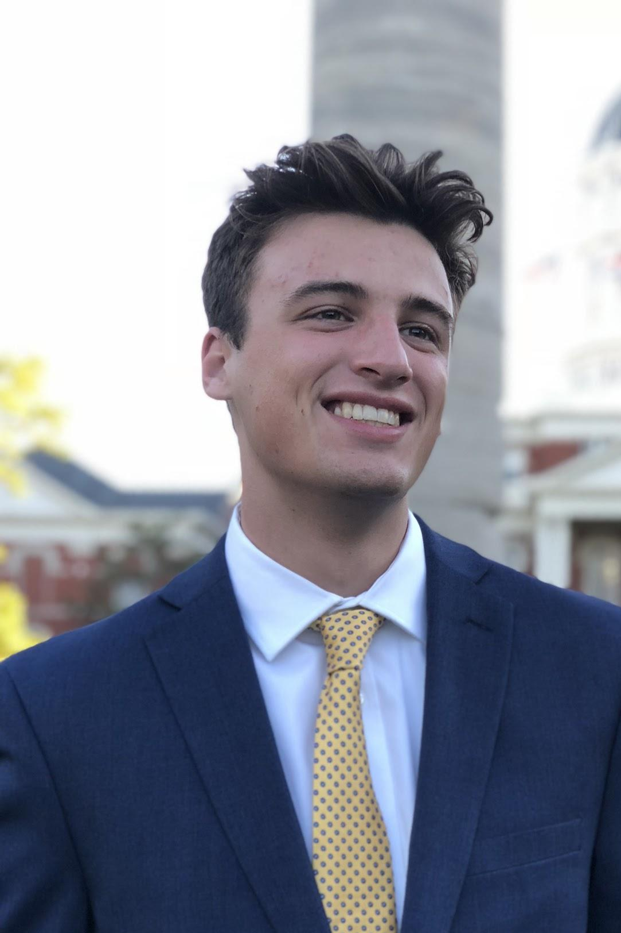
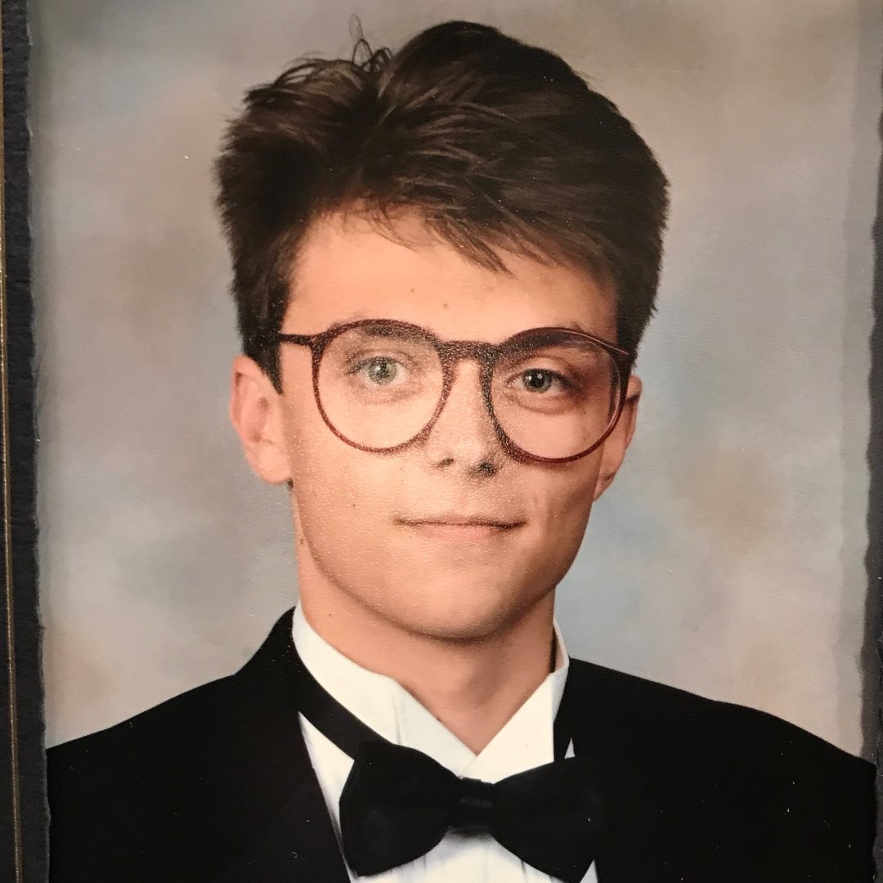
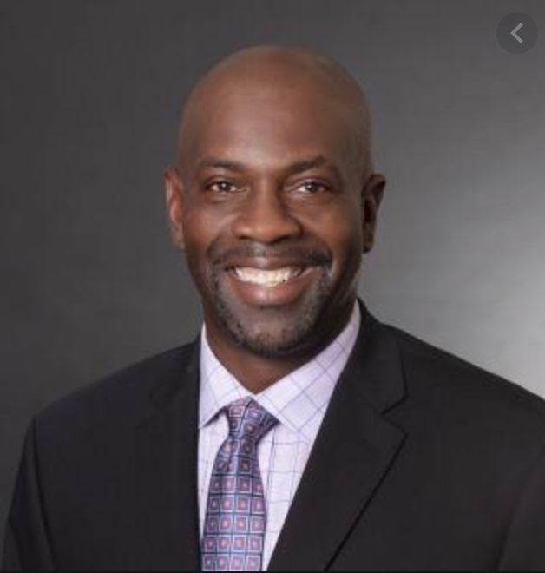

Meet the Team
Cayla Davis
Business
Emily Butera
Journalism
Kaitlyn Zahn
Computer Science
Andrew Moore
Journalism
Thomas Auckland
Architecture
Anthony Ross
Faculty Mentor
Reimagining the Game Day Experience / May 05, 2020 / Ⓒ 2020 AT&T Intellectual Property - AT&T Proprietary (Internal Use Only)
2

Slide 3

STADIUMS
FAUROT FIELD
ARENAS
E-SPORTS
Reimagining the Game Day Experience / May 05, 2020 / Ⓒ 2020 AT&T Intellectual Property - AT&T Proprietary (Internal Use Only)
3

Slide 4





4 Types
of Fans
Students
Families
Alumni
Visitors
Reimagining the Game Day Experience / May 05, 2020 / Ⓒ 2020 AT&T Intellectual Property - AT&T Proprietary (Internal Use Only)
4

Slide 5

Students are the biggest opportunity for Mizzou Athletics
They are on campus
They bring an unparalleled energy
Lowest price-point, highest population
Athletic department focus
Reimagining the Game Day Experience / May 05, 2020 / Ⓒ 2020 AT&T Intellectual Property - AT&T Proprietary (Internal Use Only)
5

Slide 6


The BIG Idea
How do we use 5G to get students off the couches and engaged in the game?
We’re competing with the couches!
Reimagining the Game Day Experience / May 05, 2020 / Ⓒ 2020 AT&T Intellectual Property - AT&T Proprietary (Internal Use Only)
6

Slide 7

RESEARCH
Started with secondary to inform the primary
Reimagining the Game Day Experience / May 05, 2020 / Ⓒ 2020 AT&T Intellectual Property - AT&T Proprietary (Internal Use Only)
7

Slide 8
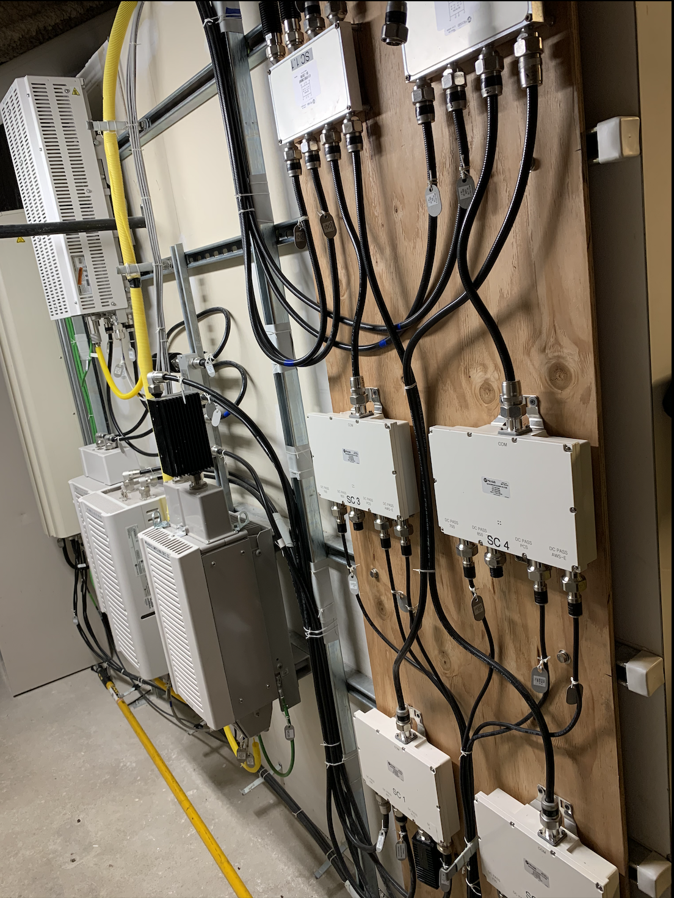
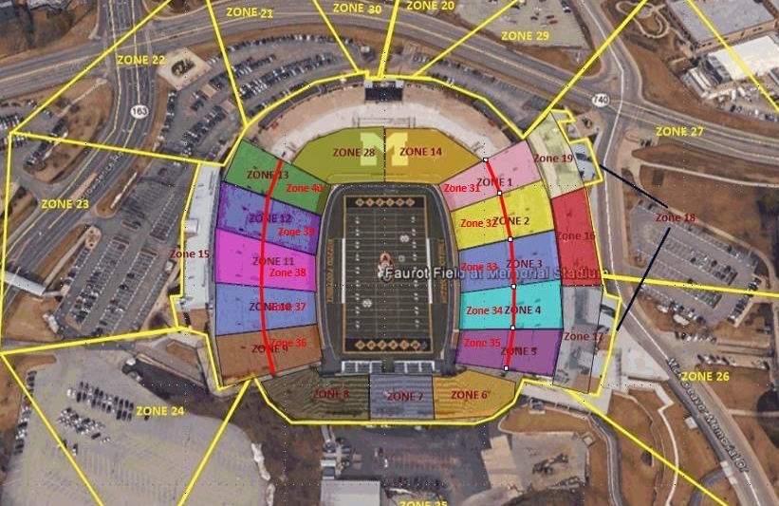
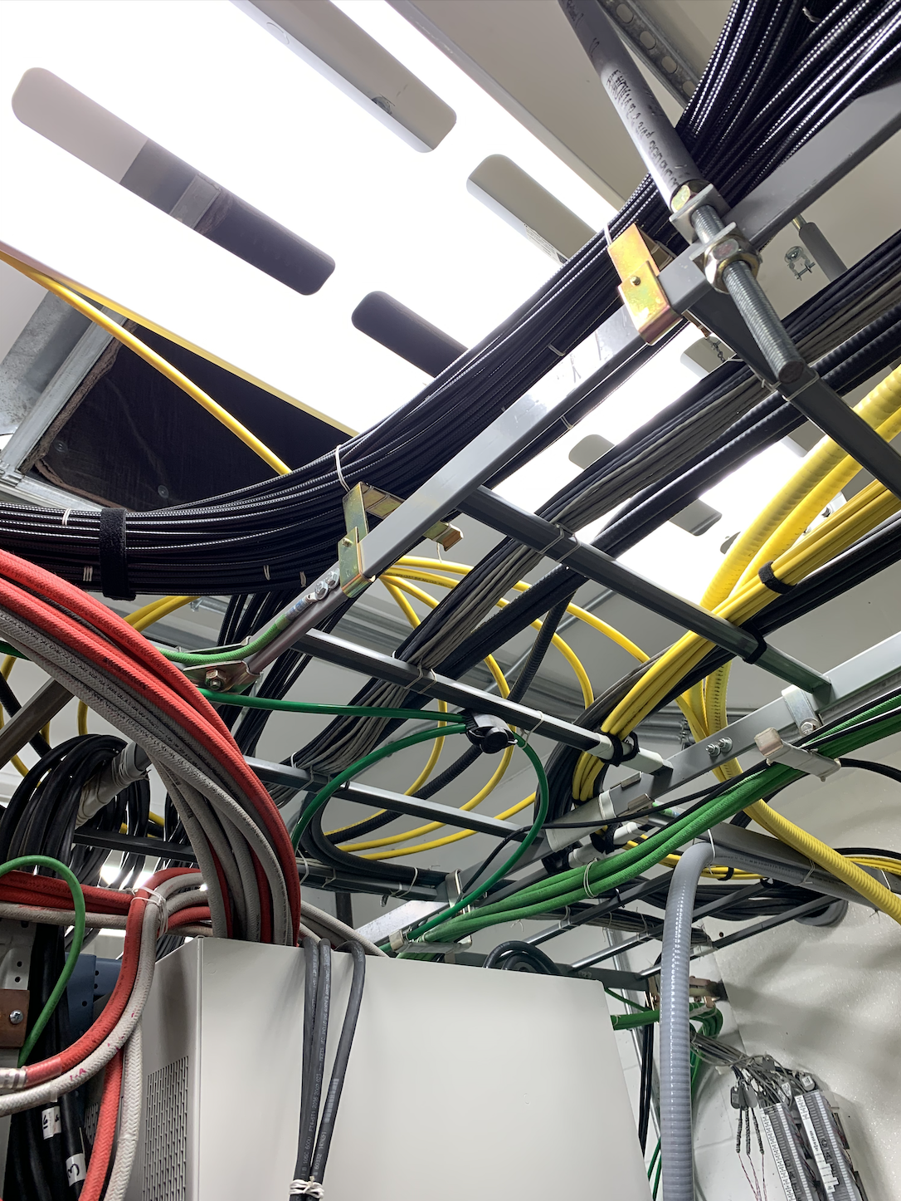
Stadium Visit
Reimagining the Game Day Experience / May 05, 2020 / Ⓒ 2020 AT&T Intellectual Property - AT&T Proprietary (Internal Use Only)
8

Slide 9
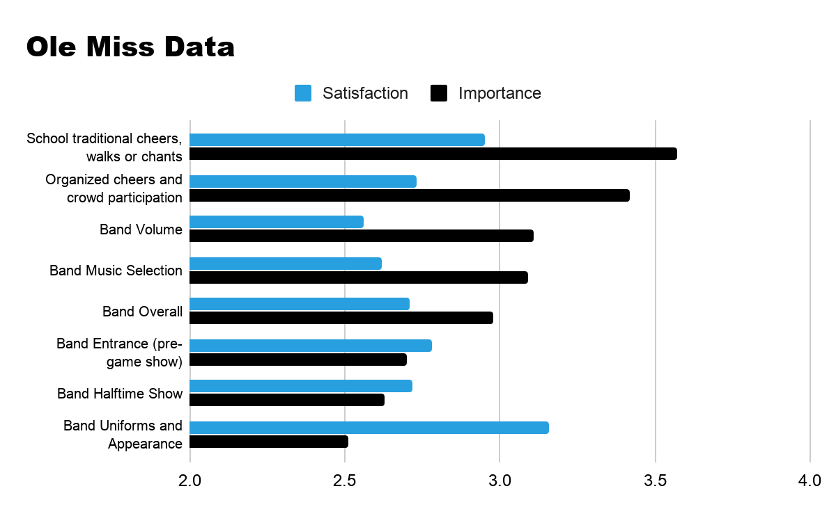
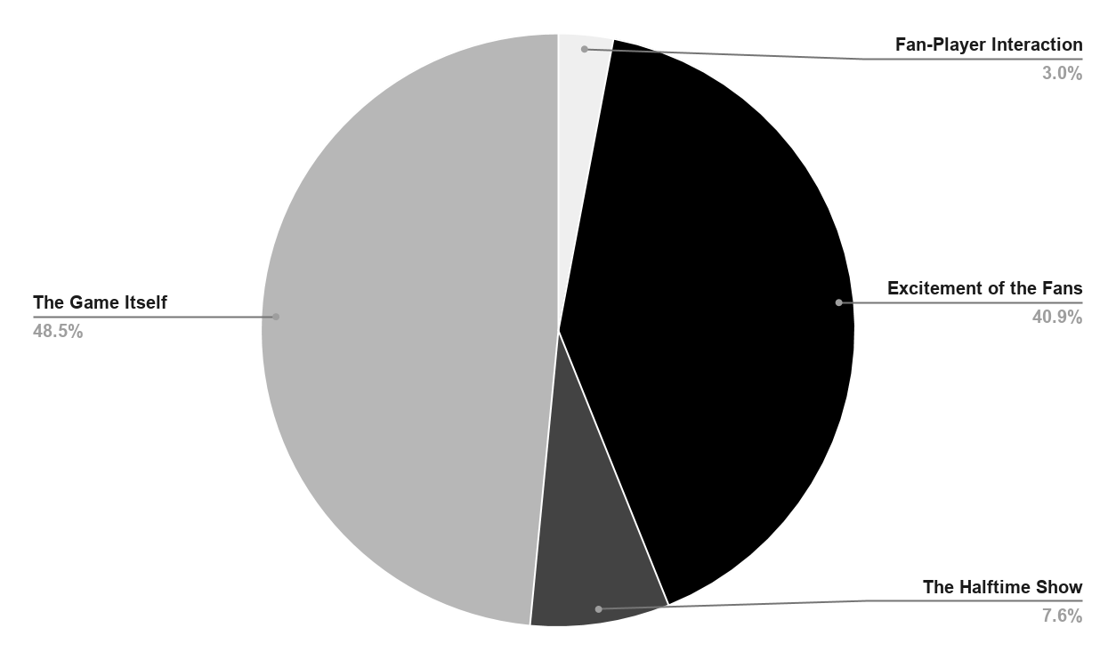
Secondary Research- Ole Miss
Students were surveyed on first impressions, concessions, restrooms, fan engagement, video/audio, connectivity. etc.
Primary Research
Important to incorporate both the game and fan experiences into solution
Reimagining the Game Day Experience / May 05, 2020 / Ⓒ 2020 AT&T Intellectual Property - AT&T Proprietary (Internal Use Only)
9

Slide 10

Why do students watch from the couch?
Game schedules are inconvenient
It’s difficult to find a parking spot
Restrooms and concessions are too busy
Downloading tickets is confusing
There aren’t any incentives to go to the game
The aspect of Mizzou traditions is currently lacking
Reimagining the Game Day Experience / May 05, 2020 / Ⓒ 2020 AT&T Intellectual Property - AT&T Proprietary (Internal Use Only)
10

Slide 11
We want our new 5G experience to include:
An incentive that is something no fan is going to want to miss out on
An easy way for fans to access game scheduling, rosters, replays, etc.
Interactive, unique technological experience that you cannot see anywhere else
A convenient way to buy and download tickets
Reimagining the Game Day Experience / May 05, 2020 / Ⓒ 2020 AT&T Intellectual Property - AT&T Proprietary (Internal Use Only)
11

Slide 12


INTRODUCING
THE
MOBILE
SHOW ME
12

Slide 13




New Mizzou Tradition
Gameday
Parade
Fun, Music, and Huge Screens
Where does
5G fit?
Reimagining the Game Day Experience / May 05, 2020 / Ⓒ 2020 AT&T Intellectual Property - AT&T Proprietary (Internal Use Only)
13

Slide 14
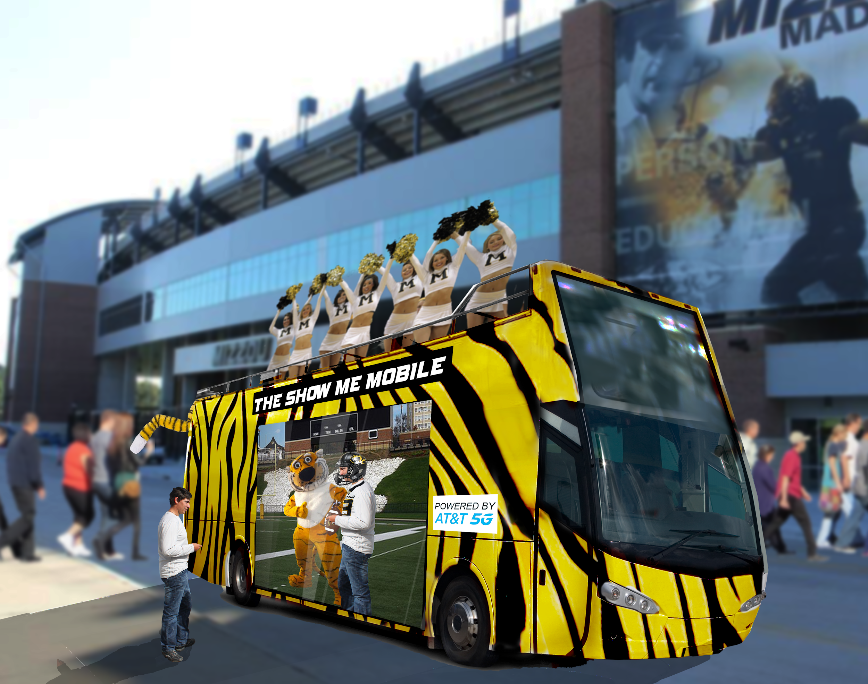
14

Slide 15
WHERE IS THE MONEY?
Drives ticket sales
$2 fee for non-ticket holders
Exclusive AT&T benefits
5G Test Zone
Reimagining the Game Day Experience / May 05, 2020 / Ⓒ 2020 AT&T Intellectual Property - AT&T Proprietary (Internal Use ONly)
15

Slide 16
What platform would those experiences be on?
How do we get people to stay for the game?
Reimagining the Game Day Experience / May 05, 2020 / Ⓒ 2020 AT&T Intellectual Property - AT&T Proprietary (Internal Use Only)
16

Slide 17
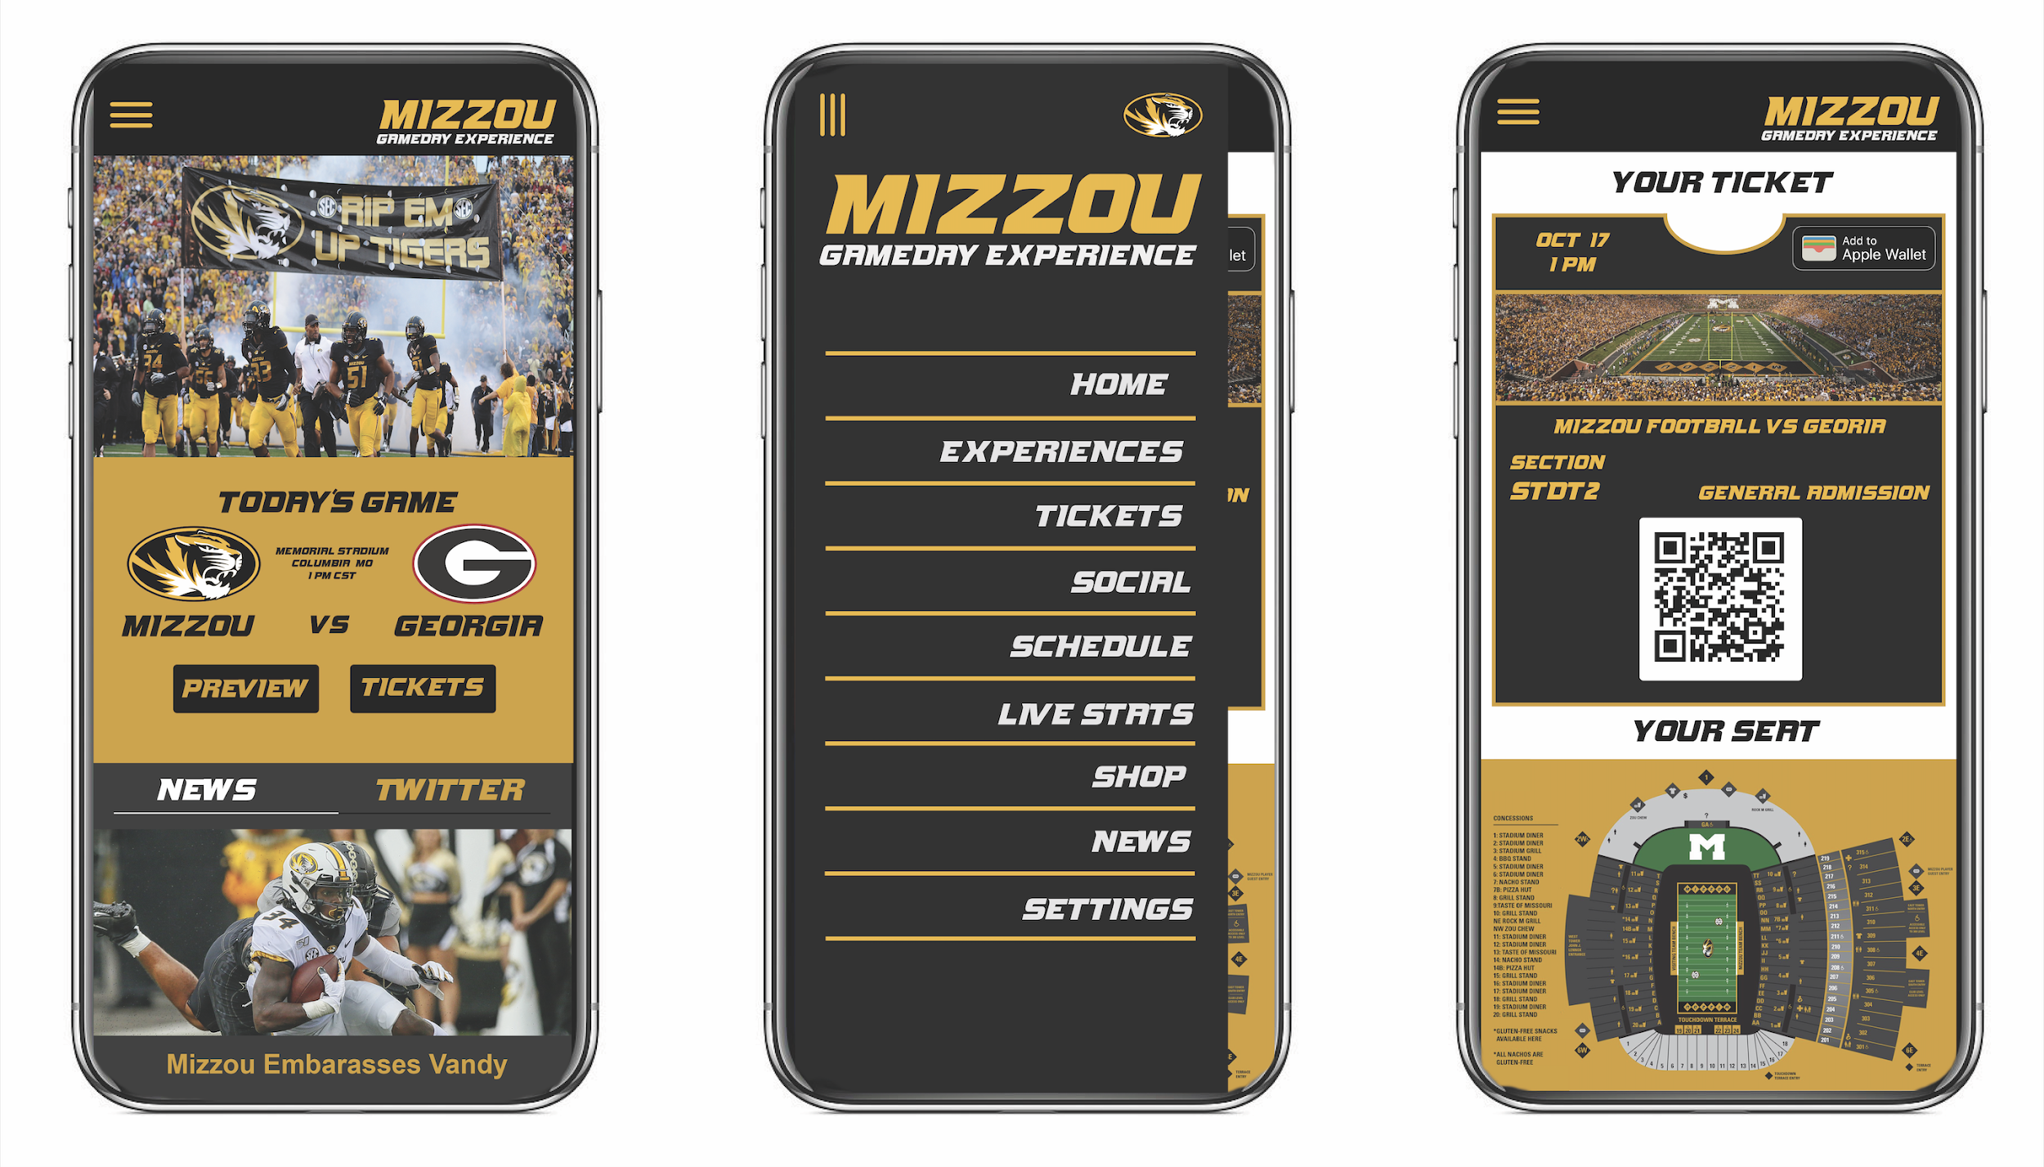
THE MIZZOU GAMEDAY APP
17

Slide 18

Mizzou Gameday App: Why It Works
Fan interaction from anywhere
Support from students & Mizzou Athletics
Utilizes 4G now and 5G later
Previous success for other teams
Reimagining the Game Day Experience / May 05, 2020 / Ⓒ 2020 AT&T Intellectual Property - AT&T Proprietary (Internal Use ONly)
18

Slide 19
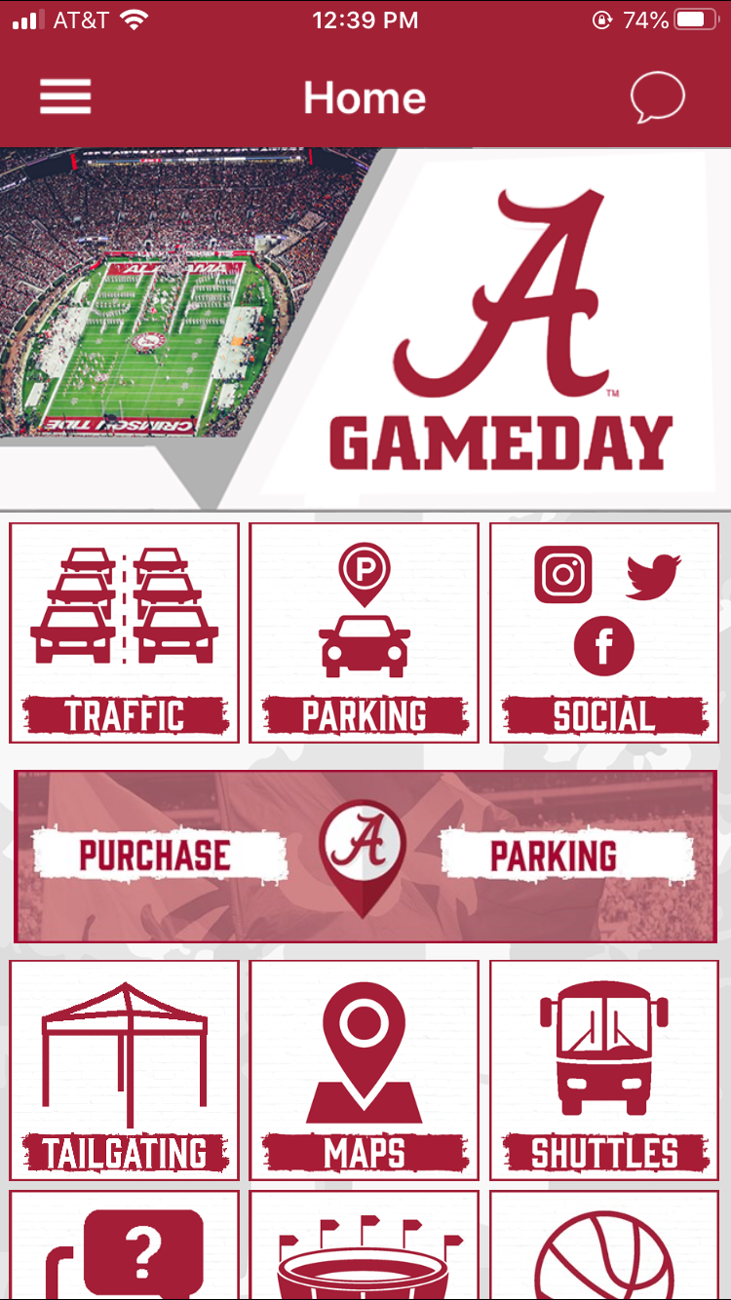
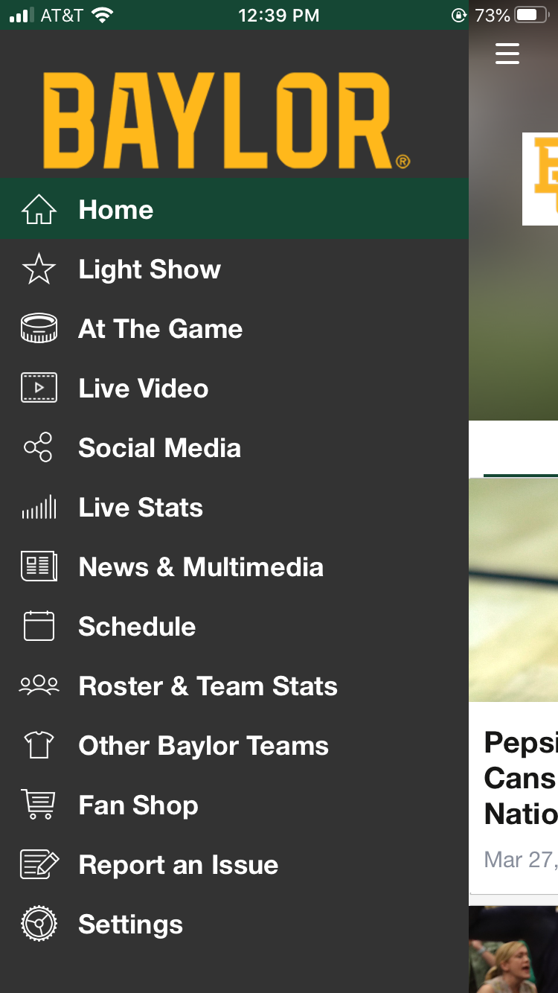
19

Slide 20
Sections of the App
4G LTE
Tickets/QR Scanner
Navigation
Find tailgates, parking, seats, the Show Me Mobile
Social
Schedule
Stats
Payment method
5G
Interactive 5G experiences
Replays from any angle
Enhanced location services
Chat rooms
Concession ordering
Live stats
Reimagining the Game Day Experience / May 05, 2020 / Ⓒ 2020 AT&T Intellectual Property - AT&T Proprietary (Internal Use Only)
20

Slide 21
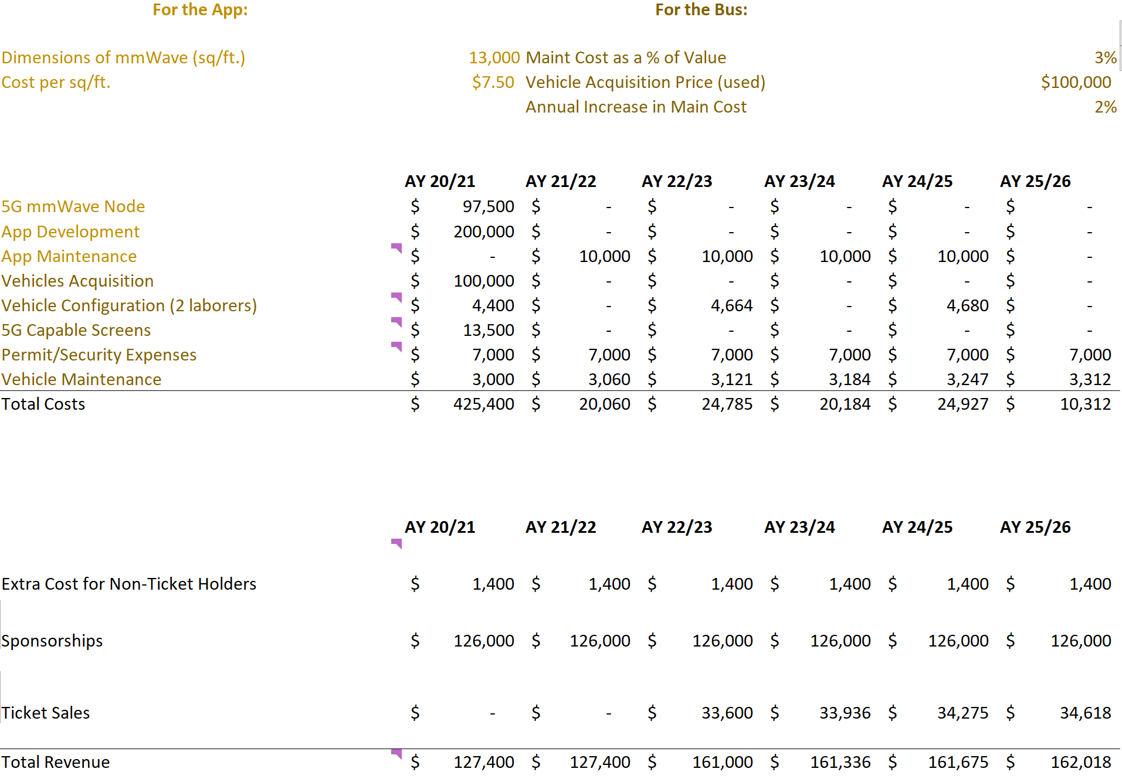
FINANCIAL ANALYSIS: Cost Assumptions
Reimagining the Game Day Experience / May 05, 2020 / Ⓒ 2020 AT&T Intellectual Property - AT&T Proprietary (Internal Use ONly)
21

Slide 22
FINANCIAL ANALYSIS: Revenue Assumptions
NPV | IRR | PAYBACK
$375,161 | 33% | 2.39 YRS
Reimagining the Game Day Experience / May 05, 2020 / Ⓒ 2020 AT&T Intellectual Property - AT&T Proprietary (Internal Use ONly)
22

Slide 23
Future Opportunities to 5G
AT&T
Expansion from college game days
Professional sports
Music festivals
Concerts
Dynamic opportunities for 5G capable screens
Mizzou
Not just for football
Mizzou Arena
Tiger Walk
Senior Send-off
Homecoming
Community wide tradition
True/False Film Festival
Expansion of mmWave implementation
Reimagining the Game Day Experience / May 05, 2020 / Ⓒ 2020 AT&T Intellectual Property - AT&T Proprietary (Internal Use Only)
23

Slide 24

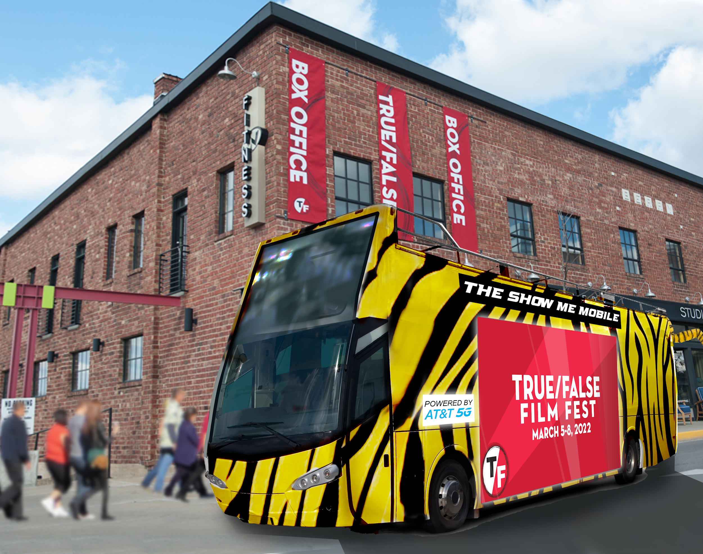
24

Slide 25
Next Steps
Continued research to specify what 5G experiences our target audience would want to see in the Show Me Mobile
Finalize features on the app
Design app UI
Facilitate conversations between Mizzou and AT&T to begin cost negotiations
Reimagining the Game Day Experience / May 05, 2020 / Ⓒ 2020 AT&T Intellectual Property - AT&T Proprietary (Internal Use Only)
25

Slide 26
LEARNINGS
The world is constantly throwing us new challenges to overcome, and it is crucial to introduce ideas that are adaptable in many different environments.
The importance of collaboration and interdisciplinary teamwork
5G can do way more than we ever imagined, and has endless possibilities in the world of marketing and technology
Reimagining the Game Day Experience / May 05, 2020 / Ⓒ 2020 AT&T Intellectual Property - AT&T Proprietary (Internal Use Only)
26

Slide 27
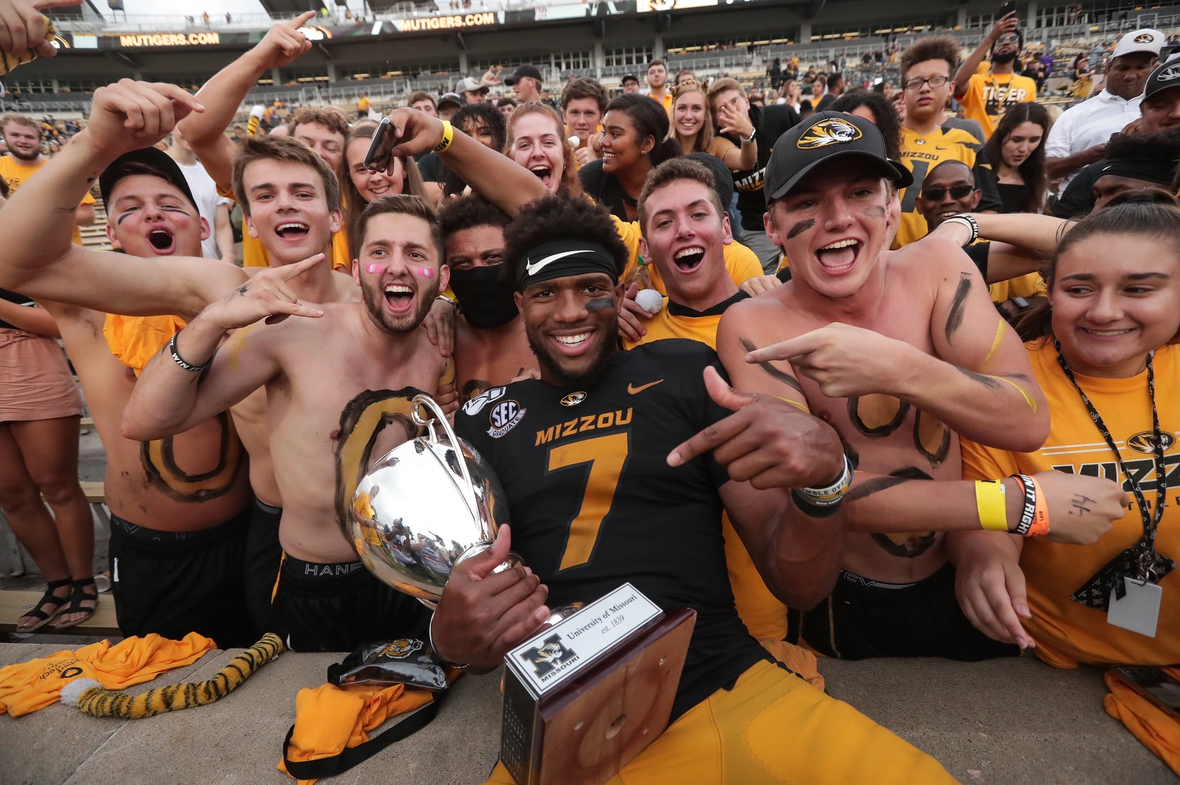
Questions?
27

